Slide 1

IS Datathon
Team 5
Wang-Han Li
Chung-Hao Lee
Fabienne Yang

Slide 2
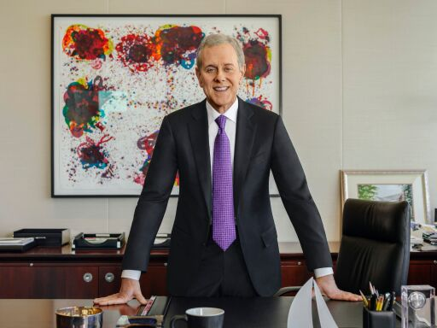
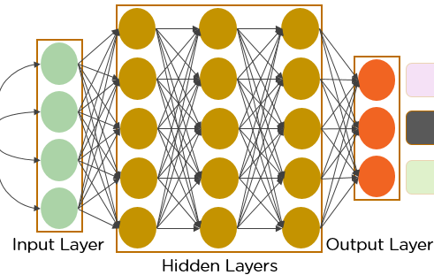
Goal
Keywords:
headshots
portraits
srs
steve swartz
steven r. swartz
Input
CNN Model
Output

Slide 3
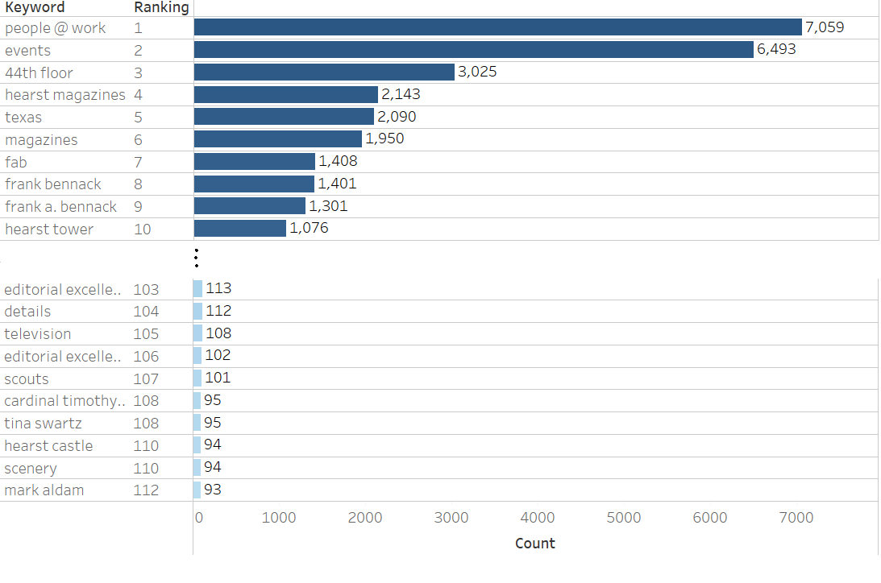
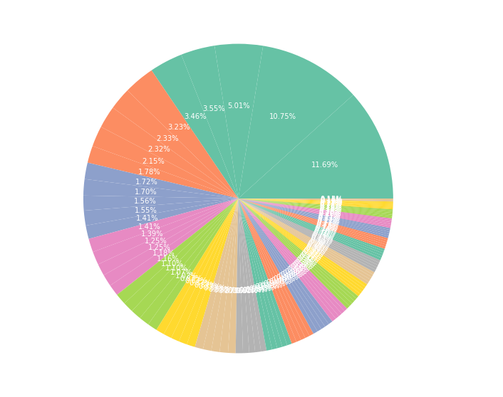
Keyword Exploration
Filter out four digit Year and
keyword counts < 93 (1% data points)
1388 keywords
112 keywords
Notes:
Filter out Year, Nan
Filter out keyword counts < 93 (1%)

Slide 4
Data Processing
Step1: Split keywords
Step3: Filter out year and low frequency keywords
Portraits,Headshots,2017,Steven R. Swartz,revised 2022
portraits | headshots | 2017 | steven r. swartz | revised 2022
Portraits | Headshots | 2017 | Steven R. Swartz | revised 2022
portraits | headshots | steven r. swartz
Step2: Convert keywords to lowercase
Step4: Connect image with keywords
Portraits | Headshots | 2017 | Steven R. Swartz | revised 2022
portraits, headshots, steven r. swartz
portraits | headshots | 2017 | steven r. swartz | revised 2022

Slide 5
Build Image Classification Model
Step5: Split dataset
Step7: Prediction output (image tagging)
CNN Model
80 %
20%
Training set
Test set
portraits, headshots, steven r. swartz
Step6: Train CNN model
Step8: Compute accuracy
portraits, headshots, steven r. swartz
portraits, headshots, steven r. swartz
prediction
match!
correct answer
portraits, headshots, steven r. swartz
CNN Model

Slide 6
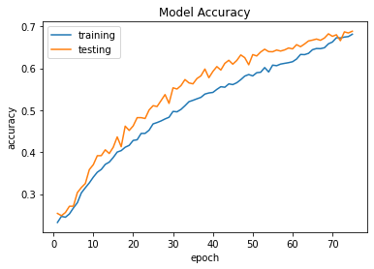
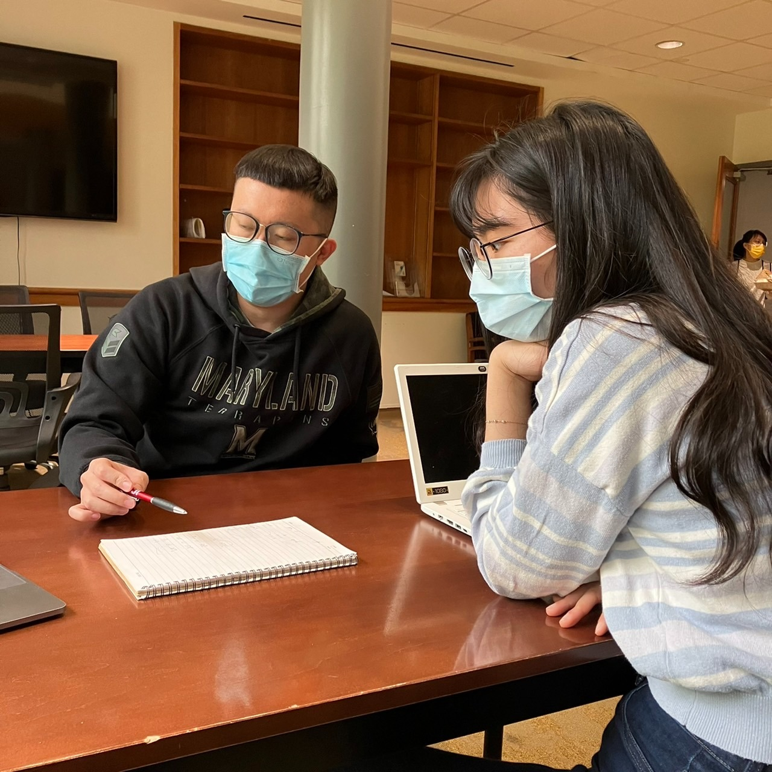
Model Performances
Best model has highest testing accuracy: 68.86%
Output examples:
portraits, headshots, steven r. swartz
 | Dropout | Augmentation | Keywords filtering | Accuracy
Best model |  |  |  | 68.86%
Model A |  |  |  | 65.83%
Model B |  |  |  | 64.69%
Model C |  |  |  | 51.31%
people @ work, the long gray line, events, homecoming, 44th floor

Slide 7
Structure of Our Best CNN Model
Feature Extraction
Classification
Input
Layer 1
Layer 2
Layer 3
Layer 4
Layer 5
Fully Connected Layer
Output
Convolution
out channels: 256
kernel size: 3
stride: 1
padding: 1
Convolution
out channels: 256
kernel size: 3
stride: 1
padding: 1
Linear
in features: 256*4*4
out features: 2048
Argmax
portraits,
headshots,
srs,
steve swartz,
steven r. swartz
. . .
ReLu
Normalization
Normalization
Dropout 50%
ReLu
ReLu
Linear
in features: 2048
out features: 670
Batch size: 32
Learning rate: 0.001
Optimizer: Adam
Epoch: 75
Max Pooling
kernel size: 2
Max Pooling
kernel size: 2

Slide 8
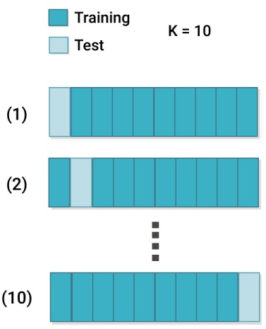
Next Step: Improve Model Accuracy
Add more convolutional layers
Transfer learning
Use k-Fold cross-validation
Number of Layers | Testing Accuracy
3 | 49.38 %
4 | 63.28 %
5 | 68.86 %

Slide 9
Summary
Successfully created an image classifier help editors better search and describe media at scale.
Change hyperparameters can enhance the model performance.
Dropout increased accuracy by 3.03 %
Augmentation increased the accuracy by 4.17 %
Keyword filtering increased the accuracy by 17.55 %
5 layers model increased the accuracy by 19.48 % (compared to 3 layers model)
Trial and error method and some practices to find the best model.

Slide 10
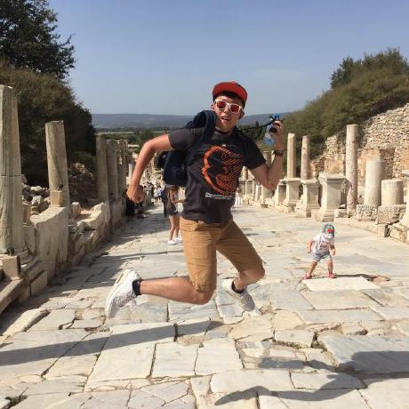

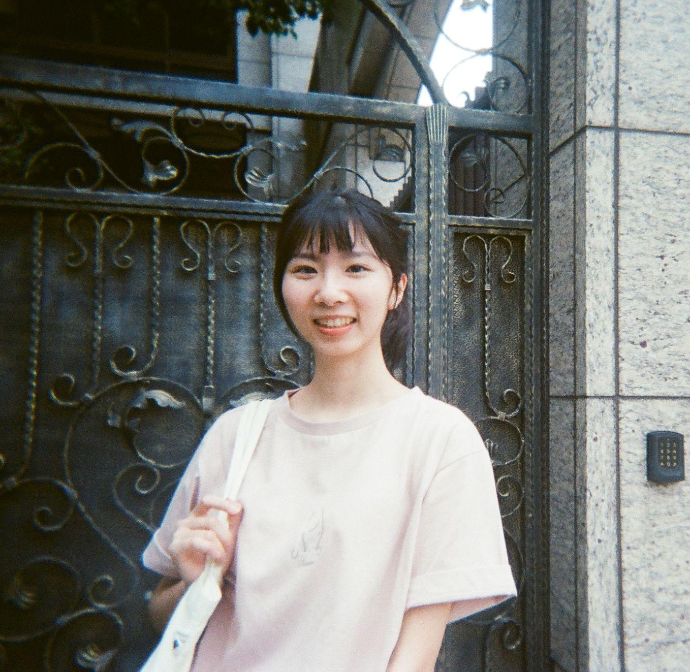
Thank You
https://github.com/lch99310
https://www.linkedin.com/in/lch99310
chunghao.lee@marylandsmith.umd.edu
https://github.com/whl0217
https://www.linkedin.com/in/wang-han-li-5b789913b
wang-han.li@marylandsmith.umd.edu
https://github.com/FabienneYang
https://www.linkedin.com/in/fabienne-yang/
fabienne.yang@marylandsmith.umd.edu

